Slide 1


AirBed&Breakfast
Discover the Best Airbnb Listings: An Interactive Data Analysis Tool

Slide 2



Airbnb
6M
Active listings worldwide
220+
countries and regions
A web platform where users can rent out their space to host travelers to

Slide 3




Challenge
Helping customers to have a more informed decision when choosing from Airbnb listings by providing a visual overview and a tool to filter based on customers needs including:
Price Range
Reviews
Property Type
Room Type

Slide 4

The Data

Slide 5



About the Data
The observations in this data set represents some of the best Airbnb listings in 10 different cities.
200,000+
33
1,000+
Observations
Variables
Null Values
Notes:
The data set has more than 200.000 observations and 33 variables.
The observations in this data set represents some of the best Airbnb listings in 10 different cities
The data set was downloaded from the website Maven Analytics.

Slide 6








Variables of Interest
City
Property Type
Host is super host
Price
City the Listing is in. 10 different cities (String)
More than 100 different properties (String)
Binary field to determine if the Host is a Superhost (Boolean)
Listing price per night, reported in each country’s currency (Number)
Neighborhood
Room Type
Amenities
Review score rating
Neighborhood the Listing is in. 660 different neighborhoods (String)
4 different room types (String)
Listed amenities provided by the host
Listing's overall rating out of 100. (Number)
Notes:
Host is super host: Binary field to determine if the Host is a Superhost (Boolean)
City: City the Listing is in. 10 different cities (String)
Neighbourhood: Neighborhood the Listing is in. 660 different neighborhoods (String)
Property type: more than 100 different properties (String)
Room type: 4 different room types (String)
Price: Listing price per night, reported in each country’s currency (Number)
Review score rating: Listing's overall rating out of 100. (Number)
Amenities: Listed amenities provided by the host

Slide 7
Pivot Data
New Fields
Data Cleaning & Preparing
To calculate new information based on in-field data (“Amenities” & “Reviews”)
Several calculated fields
Calculated Field
Price in dollar: Converting “Prices” from local to USD
Negative sentiment: Interpreting the “review scores”
Splitting data: Splitting “Amenities” values into multiple fields
Missing Data
Null Values
Discovering, Deleting or Replacing
Notes:
Data Cleaning and processing (or preparing)
Data didn't have big issues with cleaning more than null values which were dealt using the filter function from Tableau.
For data processing (or preparing) several calculated fields were created. For instance:
Price in dollar: As the price was in each country’s currency, we did the conversion to USD$
Negative sentiment: To evaluate which city has lowest score review

Slide 8

Dashboard

Slide 9
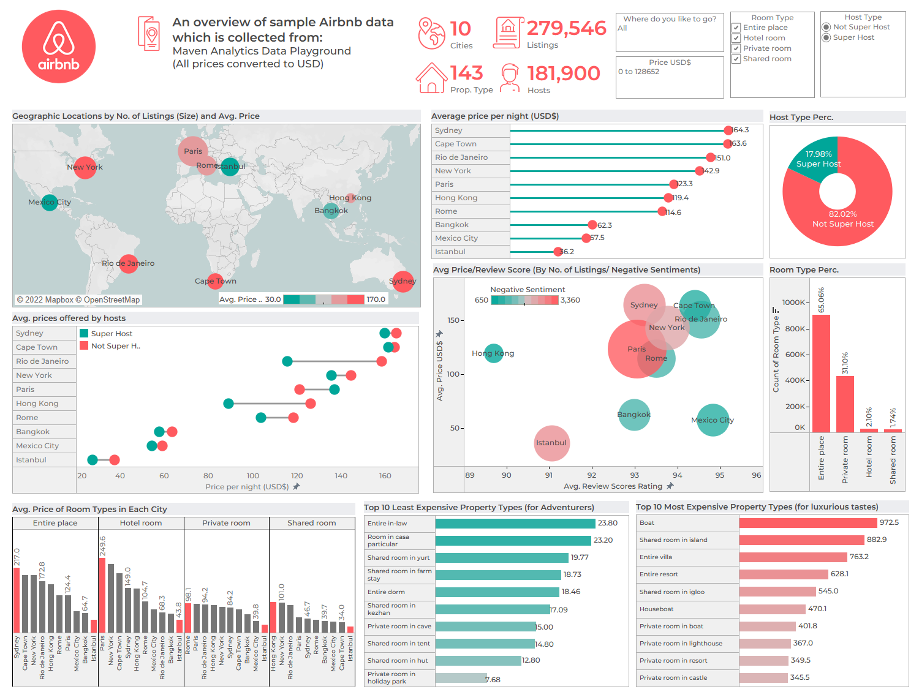
The most expensive city
Sydney is the most expensive city by average price (US$)
Paris
Paris is the city with both highest no. of listings and highest no. of negative reviews.
Super Hosts
In all cities (except for Paris) avg. prices offered by Super Hosts are lower than other hosts.
Notes:
The dashboard is an interactive one and designed toward the needs of an audience who wants to choose a destination to book an Airbnb listing.
This dashboard can be controlled using the filters on the top right corner of the dashboard.
The variables that can be controlled are:
City, Price per night range, Room type, and host type and the user can adjust these filter to help her find a suitable listing for herself.
One of the interesting findings that can be seen on this dashboards is that by average price in US$, Sydney is the most expensive city in this dataset, followed closely by Cape Town. Which can be illustrated in both charts here.
Other interesting point is that Paris is both the city with the most listings and city with the most negative review scores., which can be seen in this chart.
Also, we can see here that super-hosts (in other words, host with distinctive high review scores) in general have lower prices, well, except for Paris.
Other charts each shows an aspect of the data that is possibly useful for the dashboard’s users.

Slide 10

The Story of Sydney

Slide 11

Why Sydney?
High-end Neighborhoods
Sydney’s Story
Expensive Properties
Amenities
Notes:
This Story has 4 parts:
Why Sydney?
The most expensive neighbourhoods
The most expensive Property types in these neighbourhoods
And The amenities or facilities of these properties.
As you can see this story will be a drill-down kind of story and will explore the data vertically.

Slide 12
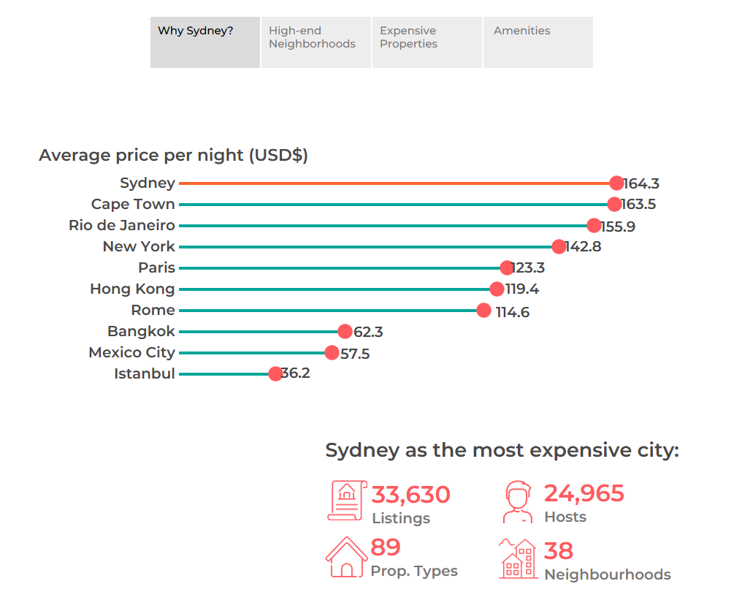
Notes:
As you can see in this chart, Sydney is the priciest city in our dataset and on average is about 5 times more expensive that Istanbul which is on the bottom of the list.
Other statistics about Sydney is that in our dataset it has about 11% of the no. of the listings and includes 38 neighbourhoods and 89 property types.
Let’s see which neighbourhoods are the most expensive ones and what characteristics they have

Slide 13
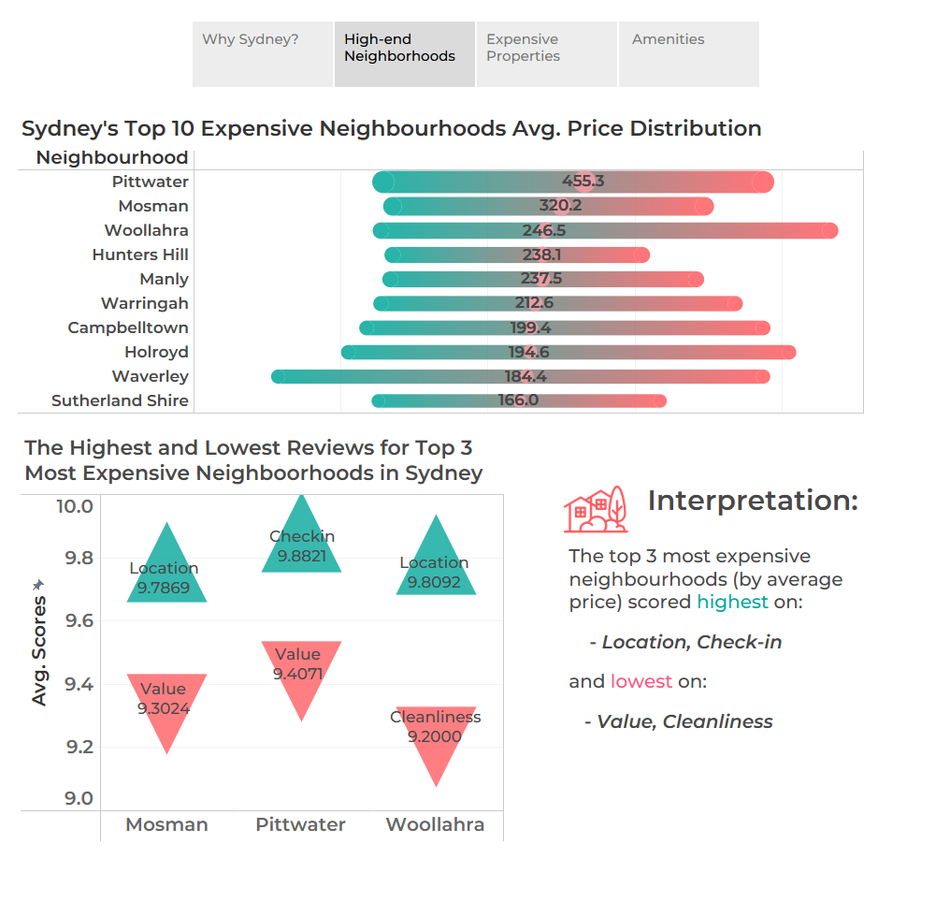
Notes:
The chart in the top shows the price range and average price of the top 10 most expensive neighborhoods in Sydney. As you can see the most priciest neighborhood is approximately 3 times more expensive than the 10th neighborhood.
In the bottom chart we’ve tried to show the strong and weak points of each of top 3 neighborhoods based on their score in each of the review scores.
And as you can see these points in this chart.

Slide 14
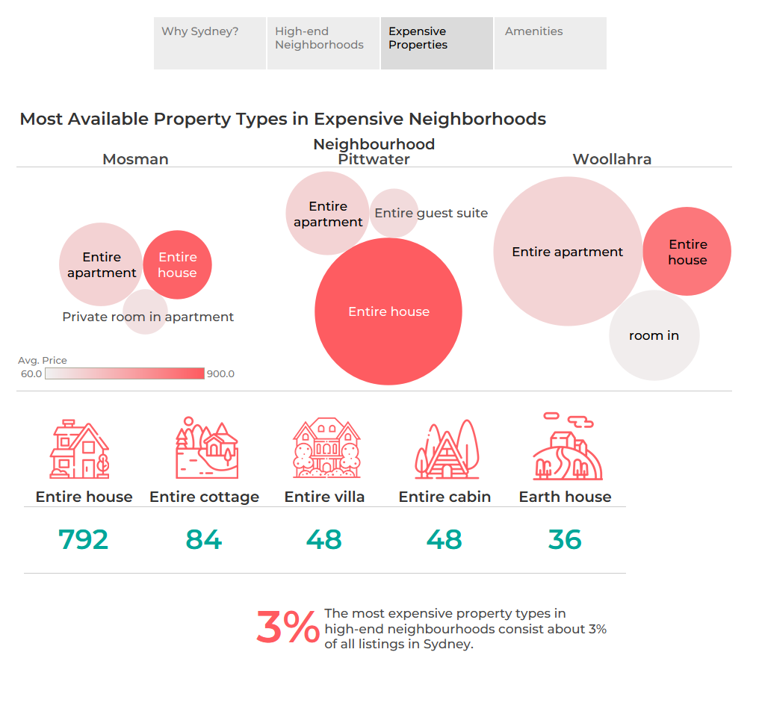
Notes:
In the next slide we’ve explored the most expensive property types in each of these selected neighborhoods.
The size here shows the number of listings in this chart and the color illustrates the avg’ price.
In the bottom you can see the no. of each property types in these neighborhoods. These listings consists 3% of all the listings in the Sydney. (Based on our dataset)

Slide 15
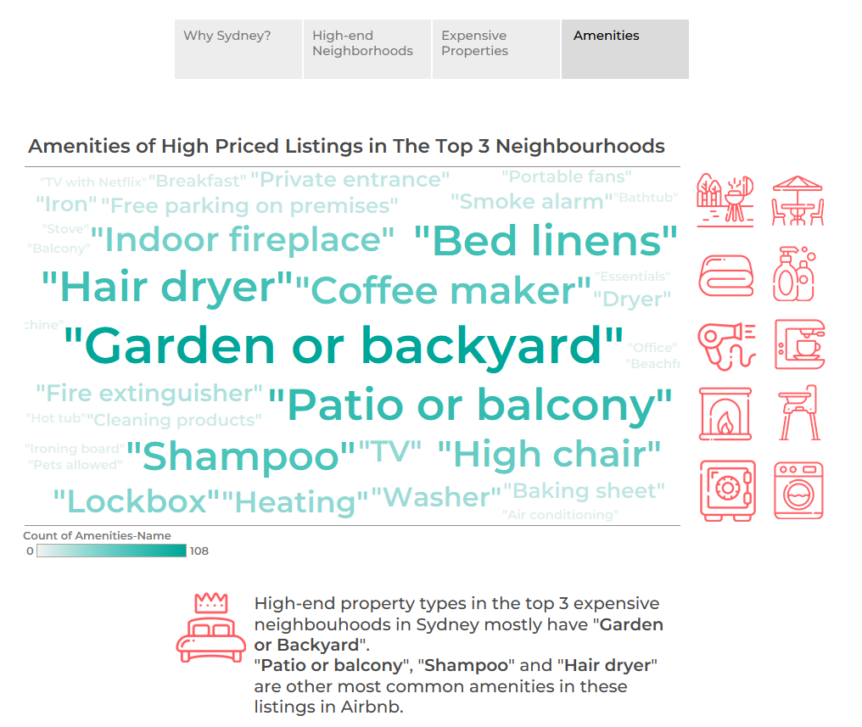
Notes:
Now here we wanted to show what facilities are more common in these kinds of properties.
And as you can see in this word-cloud, “Garden or backyard”, “Patio or balcony” and “shampoo” are the three most common amenities that were stated by the host of these listings.
These were the findings that we wanted to share with you using charts and data.

Slide 16
Resources
Data
Airbnb listings & reviews > https://www.mavenanalytics.io/data-playground?page=2
Pictures
https://content.r9cdn.net/rimg/dimg/43/4b/72c43e11-city-2258-17a3a42c3ab.jpg?crop=true&width=1366&height=768&xhint=1597&yhint=1522
https://blog.modsy.com/wp-content/uploads/2021/04/tr_29432b84-4b1b-437e-9b22-33184408a39a_729765_13_elsie_userview_5-scaled.jpg
https://assets.vogue.com/photos/6026a160d6d4503e97febeef/master/pass/0317-VO-WELL77-01.jpg
https://blogsmedia.lse.ac.uk/blogs.dir/30/files/2020/03/How-to-Design-A-City-Like-Amazon-image.png
https://static.dezeen.com/uploads/2020/02/house-in-the-landscape-niko-arcjitect-architecture-residential-russia-houses-khurtin_dezeen_2364_hero.jpg
Notes:
These are the resources that we utilized to create this dashboard, story and slides.

Slide 17
Credits
Maryam Aliakbari
Farzin Valiloo
Harold Espinosa

Slide 18
Thanks For Your Attention
Notes:
And thanks for you attention.

